Slide 1
Topic A:
Object-Oriented Software Development

Slide 2
Outline
Challenges of software development
Software engineering
Object-orientation
Iterative development

Slide 3
Reading Assignment
Chapter 1 – Object Oriented Software development Using Java.

Slide 4
Challenges of Software Development
Complexity of software systems
Longevity and evolution of software systems
High user expectations
Notes:
Complexity – Windows NT

Slide 5
Outline
Challenges of software development
Software engineering
  Activities and processes
  Waterfall model
  Software qualities
Object-orientation
Iterative development

Slide 6
Software Engineering
Engineering discipline concerned with all aspects of developing and delivering high-quality and useful software in a cost-effective manner
Defines activities and products.
Defines the software development processes, which define the order for carrying out the development activities and the criteria for the deliverables of the activities.

Slide 7
Software Development Activities
Requirements analysis
Design
Implementation and unit testing
Integration and system testing
Maintenance

Slide 8
Requirements Analysis
Goals
  To define the problem to be solved, i.e., to establish the functions, services, and constraints of the software to be developed.
Deliverables
  Requirements specifications itemizing the functional and nonfunctional requirements, called system [requirements] specifications.

Slide 9
Design
Goals
  To construct a solution to the problem by establishing an overall architecture of the software, by partitioning the software into components, and by identifying the relationships and dependencies among them.
Deliverables
  System design document and detailed design document, along with various diagrams and models.

Slide 10
Implementation and Unit Testing
Goals
  To implement the software design and test each individual component to ensure that each unit functions properly with respect to its specification before the units are integrated.
Deliverables
  Source code and unit testing documentation

Slide 11
Integration and System Testing
Goals
  To integrate the individual components and test the system as a whole to ensure that the entire software system functions properly with respect to its specification.
Deliverables
  System testing documentation

Slide 12
Maintenance
Goals
  To improve the system after it is already in use, e.g., correcting bugs, improving performance, enhancing functions or services, and adapting to new environments.
Deliverables
  New version and documentation of changes
  Longest and most costly activity in the software life cycle!

Slide 13
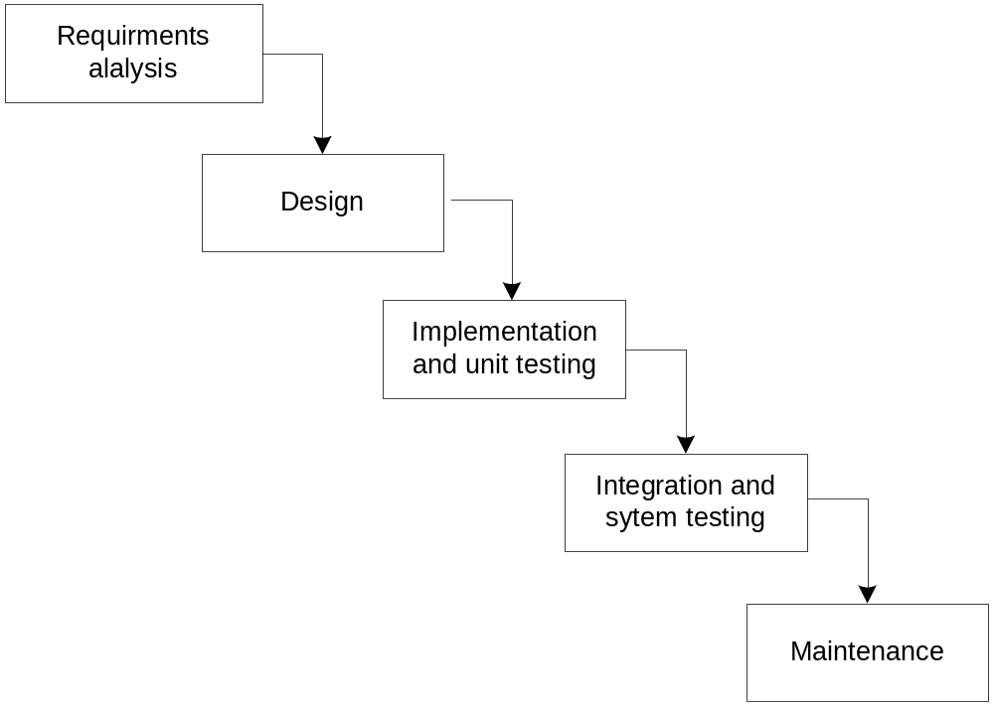
Software Development Processes
Waterfall Model

Slide 14
Waterfall (Life Cycle) Model
Characteristics
  Sequential
  Document driven
Benefits
  Discipline and formality

Slide 15
Waterfall Model (Cont.)
Critical evaluation
  Linear, rigid, and monolithic
  No accommodations for changes
  => Documents are frozen
  => Ideal model
Q: How to accommodate changes?
Incremental (or evolutionary) approach

Slide 16
Software System Qualities
Usefulness
Timeliness
Reliability
  Correctness, robustness, availability, …
Maintainability
  Maintainable, i.e., possible to make corrections, adaptations, and extensions without undue costs.
Reusability
User friendliness
Efficiency
  CPU time, memory, and disk space, etc.
…

Slide 17
Qualities (Cont.)
Are all of these qualities attainable at the same time?
Are they of equal importance?
If not, which is more important?

Slide 18
Maintainability Revisited
Maintenance costs far exceed development costs.
Reliability is attained through repeated corrections.
=> must be maintainable!

Slide 19
What Contributes to Maintainability?
Flexibility
Simplicity
Readability (understandability)

Slide 20
Flexibility
Changeable
  The various aspects of software systems should be easily changeable.
Minimal impact
  Impact of change should be confined to a small region.
  The correctness of the change should be reasoned by examining only the small affected region rather than the entire software.

Slide 21
Simplicity
Impossible to avoid making mistakes
When things are simple
  Less error-prone
  Easier to show correctness
  Errors become more obvious and correcting errors is easier.
Divide-and-conquer approach

Slide 22
Outline
Challenges of software development
Software engineering
Object-orientation
Iterative development

Slide 23
Why O-O Model?
Possible to directly represent real world objects in the computer system.
Data-oriented model
Object-oriented model
Real world
Software system
Real world
Software system

Slide 24
Outline
Challenges of software development
Software engineering
Object-orientation
Iterative development

Slide 25
Iterative Development
Key characteristics
  Consists of a number of success iterations
  Each iteration produces a working program
  Build system incrementally
Benefits
  Facilitates and manage changes
  ⬄Minimize and prevent changes
Examples
  Rational Unified Process (RUP)
  Extreme Programming (XP)
  Agile Methodologies

Slide 26
Object-Oriented Development
Approach
  Focuses on improving the maintainability and reusability of software systems through a set of techniques, notations, tools, and criteria.
Activities
  Conceptualization
  Object-oriented analysis and modeling
  Object-oriented design
  Implementation
  Maintenance

Slide 27
Detailed Activities
Conceptualization
  To establish the vision and core requirements of the software system to be developed.
Object-oriented analysis and modeling
  To build models of the system’s desired behavior, using notations such as the Unified Modeling Language (UML).
  To capture the essential relevant aspects of the real world and to define the services to be provided and/or the problems to be solved.
  To simplify reality to better understand the system to be developed.

Slide 28
Detailed Activities
Object-oriented design
  To create an architecture for implementation.
  Represented in terms of objects and classes and the relationships among them.
Implementation:
  To implement the design by using an object-oriented programming language (e.g., Java)
Maintenance:
  To manage postdelivery evolution effectively.

Slide 29
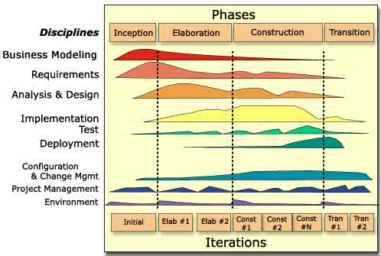
O-O Processes (e.g., RUP)

